Slide 1

Van de allereerste sessie: De packages base, datasets, graphics en stats hebben mijn speciale interesse.
Elementen uit het package base komen we voortdurend tegen, als we code lezen of maken. Hier ga ik niet systematisch op in, maar ad hoc.
Datasets uit het package datasets gebruiken we ad hoc in de lessen, vooral als we voorbeeldscripts gebruiken.

Slide 2


Slide 3
Information on package ‘graphics’
Description:
Package: graphics
Version: 3.0.2
Priority: base
Title: The R Graphics Package
Author: R Core Team and contributors worldwide
Maintainer: R Core Team <R-core@r-project.org>
Description: R functions for base graphics
Imports: grDevices
License: Part of R 3.0.2
Built: R 3.0.2; x86_64-w64-mingw32; 2013-09-25 15:39:29 UTC; windows

Slide 4
Index:
Axis Generic Function to Add an Axis to a Plot
abline Add Straight Lines to a Plot
arrows Add Arrows to a Plot
assocplot Association Plots
axTicks Compute Axis Tickmark Locations
axis Add an Axis to a Plot
axis.POSIXct Date and Date-time Plotting Functions
barplot Bar Plots
box Draw a Box around a Plot
boxplot Box Plots
boxplot.matrix Draw a Boxplot for each Column (Row) of a Matrix
bxp Draw Box Plots from Summaries
cdplot Conditional Density Plots
clip Set Clipping Region
contour Display Contours
coplot Conditioning Plots
curve Draw Function Plots
dotchart Cleveland's Dot Plots
filled.contour Level (Contour) Plots
fourfoldplot Fourfold Plots

Slide 5
frame Create / Start a New Plot Frame
graphics-package The R Graphics Package dit klopt niet? Arithmetic Operators
grconvertX Convert between Graphics Coordinate Systems
grid Add Grid to a Plot
hist Histograms
hist.POSIXt Histogram of a Date or Date-Time Object
identify Identify Points in a Scatter Plot
image Display a Color Image
layout Specifying Complex Plot Arrangements
legend Add Legends to Plots
lines Add Connected Line Segments to a Plot
locator Graphical Input
matplot Plot Columns of Matrices
mosaicplot Mosaic Plots
mtext Write Text into the Margins of a Plot
pairs Scatterplot Matrices
panel.smooth Simple Panel Plot
par Set or Query Graphical Parameters
persp Perspective Plots
pie Pie Charts

Slide 6
plot Generic X-Y Plotting
plot.data.frame Plot Method for Data Frames
plot.default The Default Scatterplot Function
plot.design Plot Univariate Effects of a Design or Model
plot.factor Plotting Factor Variables
plot.formula Formula Notation for Scatterplots
plot.histogram Plot Histograms
plot.table Plot Methods for 'table' Objects
plot.window Set up World Coordinates for Graphics Window
plot.xy Basic Internal Plot Function
points Add Points to a Plot
polygon Polygon Drawing
polypath Path Drawing
rasterImage Draw One or More Raster Images
rect Draw One or More Rectangles
rug Add a Rug to a Plot
screen Creating and Controlling Multiple Screens on a Single Device

Slide 7
segments Add Line Segments to a Plot
smoothScatter Scatterplots with Smoothed Densities Color Representation
spineplot Spine Plots and Spinograms
stars Star (Spider/Radar) Plots and Segment Diagrams
stem Stem-and-Leaf Plots
stripchart 1-D Scatter Plots
strwidth Plotting Dimensions of Character Strings and Math Expressions
sunflowerplot Produce a Sunflower Scatter Plot
symbols Draw Symbols (Circles, Squares, Stars, Thermometers, Boxplots)
text Add Text to a Plot
title Plot Annotation
xinch Graphical Units
xspline Draw an X-spline
We bekijken enkele voorbeelden:

Slide 8
> ?plot # hier halen we een voorbeeldscript op voor plot
# zo krijgen we de uitleg, die we nodig hebben
> require(stats)
> plot(cars)
> lines(lowess(cars))
>
# geeft het volgende plaatje

Slide 9
> ?plot # hier halen we een voorbeeldscript op voor plot
> require(stats)
> plot(cars)
>
# geeft het volgende plaatje
Maak hier een grafiek van.
> ?cars # voor informatie

Slide 10
> ?cars # we bekijken deze dataset en voorbeeld scripts
Description
The data give the speed of cars and the distances taken to stop. Note that the data were recorded in the 1920s.
Format
A data frame with 50 observations on 2 variables.
[,1] speed numeric Speed (mph)
[,2] dist numeric Stopping distance (ft)

Slide 11
# gekopieerd script
> require(stats); require(graphics)
> plot(cars, xlab = "Speed (mph)", ylab = "Stopping distance (ft)",
+ las = 1)
> title(main = "cars data")
>

Slide 12
# eigen script
> plot(cars, xlab = "Speed (mph)", ylab = "Stopping distance (ft)")
> title(main = "cars data from the year 1920")
>
# de bron ontbreekt nog

Slide 13
>?barplot # zo krijgen we de uitleg, die we nodig hebben
Description
Creates a bar plot with vertical or horizontal bars.
Usage
barplot(height, ...)
## Default S3 method:
barplot(height, width = 1, space = NULL,
names.arg = NULL, legend.text = NULL, beside = FALSE,
horiz = FALSE, density = NULL, angle = 45,
col = NULL, border = par("fg"),
main = NULL, sub = NULL, xlab = NULL, ylab = NULL,
xlim = NULL, ylim = NULL, xpd = TRUE, log = "",
axes = TRUE, axisnames = TRUE,
cex.axis = par("cex.axis"), cex.names = par("cex.axis"),
inside = TRUE, plot = TRUE, axis.lty = 0, offset = 0,
add = FALSE, args.legend = NULL, ...)

Slide 14
Arguments (29 stuks, waarvan we hier de eerste drie bekijken, we hoeven ze niet allemaal iedere keer te gebruiken)
height | either a vector or matrix of values describing the bars which make up the plot. If height is a vector, the plot consists of a sequence of rectangular bars with heights given by the values in the vector. If height is a matrix and beside is FALSE then each bar of the plot corresponds to a column of height, with the values in the column giving the heights of stacked sub-bars making up the bar. If height is a matrix and beside is TRUE, then the values in each column are juxtaposed rather than stacked.
width | optional vector of bar widths. Re-cycled to length the number of bars drawn. Specifying a single value will have no visible effect unless xlim is specified.
space | the amount of space (as a fraction of the average bar width) left before each bar. May be given as a single number or one number per bar. If height is a matrix and beside is TRUE, space may be specified by two numbers, where the first is the space between bars in the same group, and the second the space between the groups. If not given explicitly, it defaults to c(0,1) if height is a matrix and beside is TRUE, and to 0.2 otherwise.

Slide 15
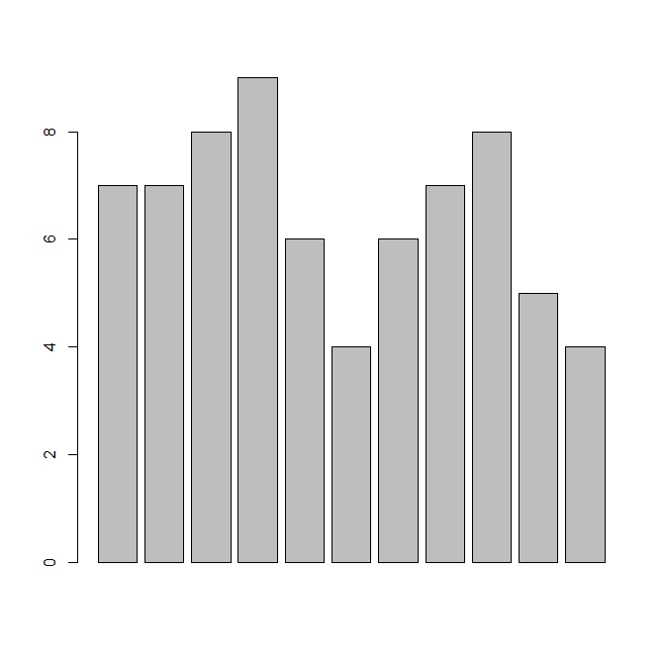
> cijfers<-c(7,7,8,9,6,4,6,7,8,5,4)
> barplot(cijfers)

Slide 16
> resultaat<-c(7,5,8,9,6,4)
> names(resultaat)<-c("Marc","Piet","Maike","Jos","Klaas","Mieke")
> barplot(resultaat)
>

Slide 17
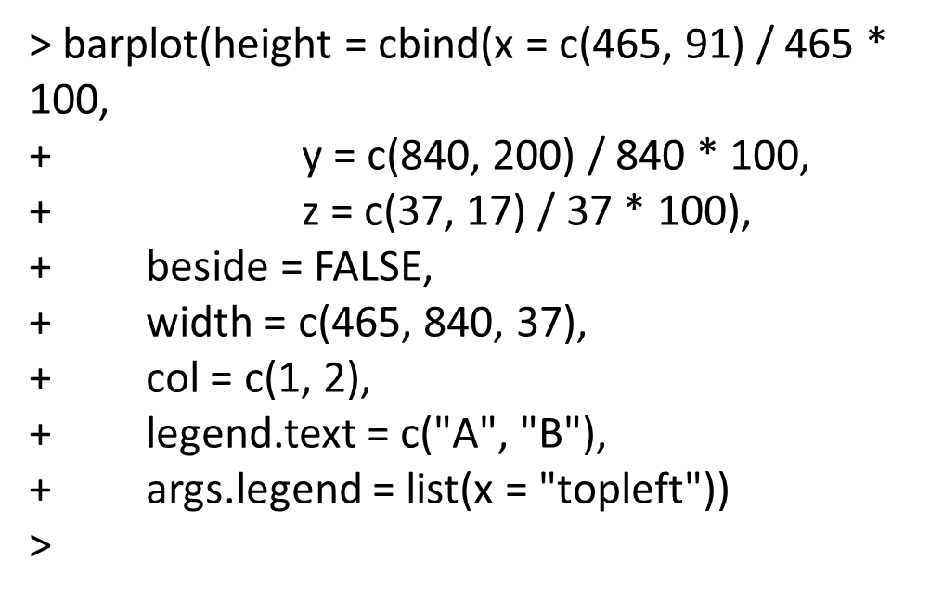
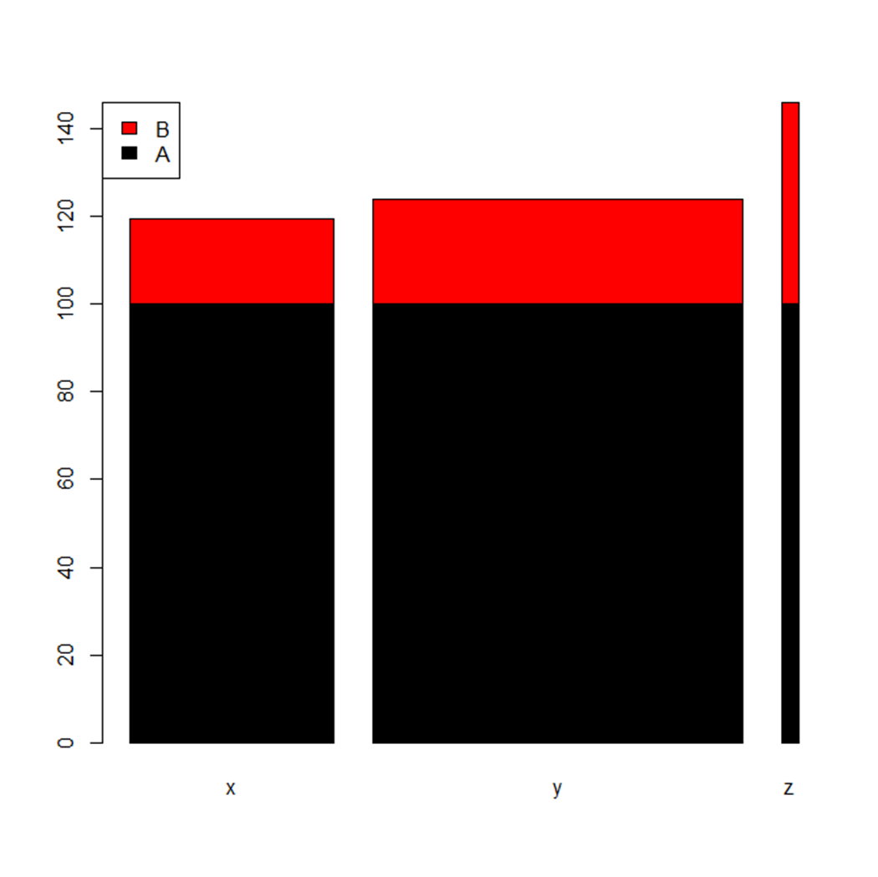
>?barplot # We kunnen ook een voorbeeld in R plakken om te kijken wat we krijgen. Gebruik het script van # args.legend

Slide 18
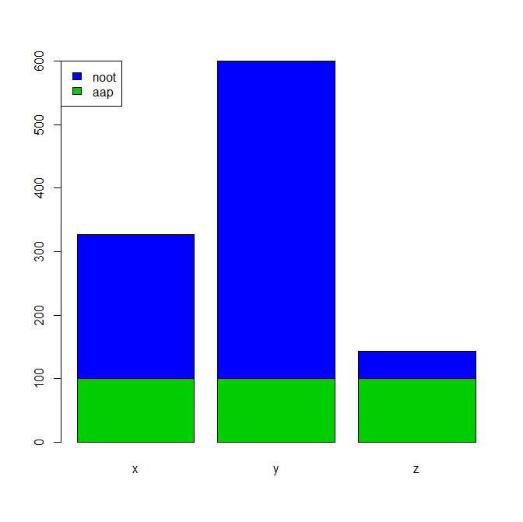
Andere waarden ingevuld.
# args.legend
barplot(height = cbind(x = c(40, 91) / 40 * 100,
y = c(40, 200) / 40 * 100,
z = c(40, 17) / 40 * 100),
beside = FALSE,
width = c(40, 40, 40),
col = c(3,4),
legend.text = c("aap", "noot"),
args.legend = list(x = "topleft"))

Slide 19
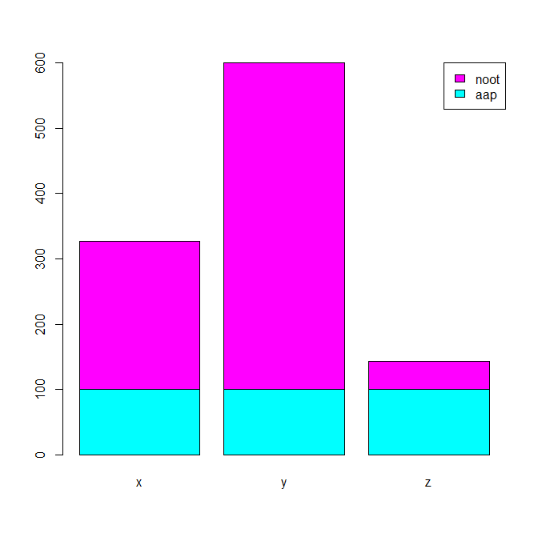
Andere waarden ingevuld.
# args.legend
barplot(height = cbind(x = c(40, 91) / 40 * 100,
y = c(40, 200) / 40 * 100,
z = c(40, 17) / 40 * 100),
beside = FALSE,
width = c(20, 20, 20),
col = c(5,6),
legend.text = c("aap", "noot"),
args.legend = list(x = "topright")

Slide 20
We nemen een naam uit de index bij package graphics : abline
>?abline # hier halen we een voorbeeldscript op
> ## Simple Regression Lines:
> require(stats)
> sale5 <- c(6, 4, 9, 7, 6, 12, 8, 10, 9, 13) # hier wordt een vector gemaakt
> plot(sale5)
> abline(lsfit(1:10, sale5)) # voegt een regressielijn toe, die door de # oorsprong gaat.
> abline(lsfit(1:10, sale5, intercept = FALSE), col = 4) # less fitting
>

Slide 21
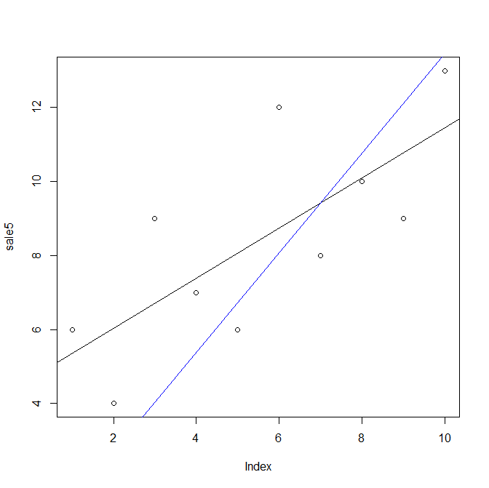

Slide 22
Je kunt proberen alles met trial and error op te lossen.
Een alternatief is
Chapter 12 Graphical procedures
van An Introduction to R doornemen, om alvast een beter idee te
krijgen van structuren. (dit is geen huiswerk)

Slide 23
At http://www.omegahat.org/ you can find a lot of packages
Omega is a joint project with the goal of providing a variety of open-source software for statistical applications.
For example: RFirefox
This embeds R within the Firefox Web browser and allows JavaScript code to call R functions and evaluate R expressions. It also allows R functions and code to access JavaScript objects and methods and so be used as event handlers and to generate dynamic content within a Web page. (Gabe Becker and Duncan Temple Lang)
REuPathDB
(Version 1.0-0) a package to interface the EuPathDB (Eukaryotic Pathogen Database Resources) Web Services via their REST API. This is machine generated code derived from the WADL files describing the Web service methods.
RExcelXML
Facilities for working with .xlsx documents, i.e. Excel 2007.
A Python module for obtaining reflectance information from C/C++ source code. This can be used to programmatically generate S bindings to arbitrary routines, classes and data structures in native code and also build the registration table for routines to be accessed from R. We can also use this to compute on C/C++ code, e.g. determining call graphs, free variables.
GccTranslationUnit

Slide 24
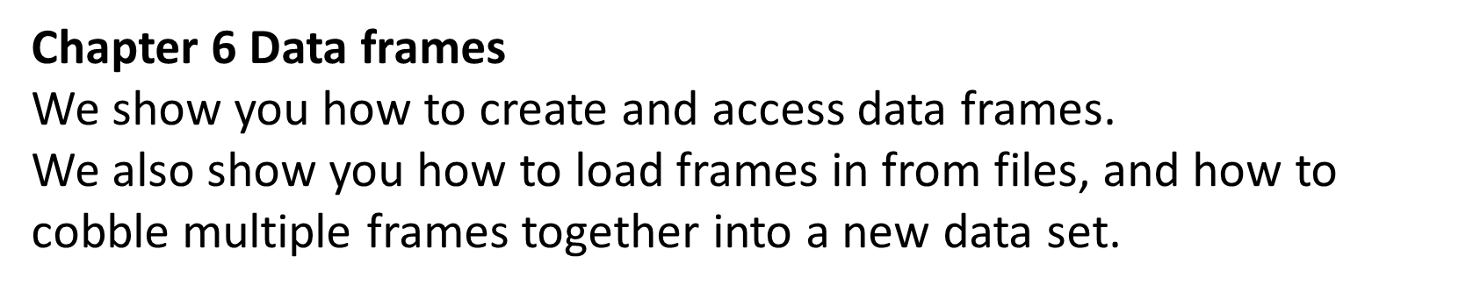
Voor volgende week van www.tryr.codeschool.com chapter 6 helemaal doorwerken.

